Slide 1
Climate: Water Consumption Calendar
Team Merritt: Matthew and Michael Merritt

Slide 2
Climate and Water Consumption
Climate change will have a severe impact on water availability in the future if trends continue
Saving water is essential for two reasons:
We need to stop wasting water and preserve some of that water for the future
We need to gradually decrease the amount we need to adapt to climate change

Slide 3
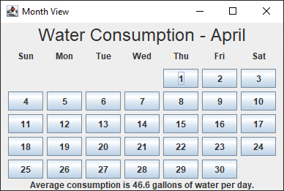
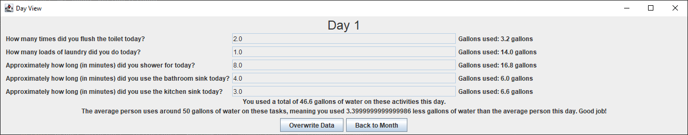
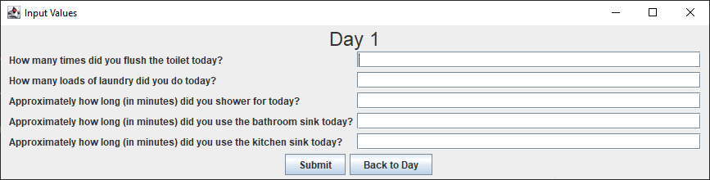
Design
Graphical application consisting of multiple windows
Allows user to input simple information about daily water consumption in order to gauge how much they waste or save on average
Saves daily water consumption over the period of a month in order to show consumption over a longer duration of time

Slide 4
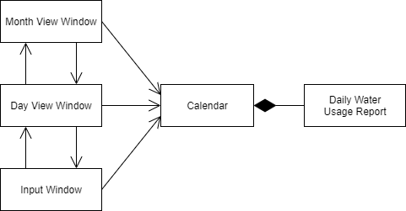
Implementation
Written in Java
GUI consists of three windows, with only one being displayed at a time
Month view window
Day view window
Input window
All the windows share a calendar which is used to store the daily consumption values

